Slide 1
Information and communication technology
Group 42 Annou Lyna
Drouna Rania Messaoudi Wissam
Ouguenoune Meriem Metouchi Yassine

Slide 2

Summary:
Introduction
ICT in Education and Business Organization
Technologies related to ICT :
Google Services
Microsoft Tools and Apps
Git and Github
HTML and CSS
Conclusion

Slide 3




Introduction:
Information and Communication Technologies (ICT) refer to an expansive domain that emphasizes the integration of various technologies, including Google services, Microsoft tools, Git, and GitHub, HTML and CSS within the broader framework of information technology and unified communications. ICT involves the convergence of digital tools and platforms that facilitate communication, collaboration, and information management.
ICT represents a comprehensive umbrella term that encapsulates a diverse array of technologies, systems, and methodologies employed in the acquisition, processing, storage, dissemination, and utilization of information.

Slide 4


ICT in Education and Business Organization:
In education:
In 2008, UNESCO emphasized the incorporation of ICT within national education efforts. In addition to being a valid goal for education, it also enhances pedagogical effectiveness. When ICT is available to teachers and students, it can enhance learning and teaching experiences. The effective usage of ICT expands learning and knowledge on local, national and global levels

Slide 5
In Business Organization:
ICT has contributed to major changes in how enterprises organize themselves internally and externally. The most significant of these is firms’ capacity to network among departments and individuals in the firm (sharing information, coordinating activity, performing operations in real time), networking among firms, and between firms and consumers.
Communications with customers is also facilitated: Cisco Systems claims that it has saved hundreds of thousands of phones calls per year because of the availability of its web site.
Individual networking is a way both to learn about working conditions, projects, and innovations in other firms and to make strategic job moves in a flexible labor market. With e-mail and the Internet, individual networking has no spatial or temporal limits.

Slide 6
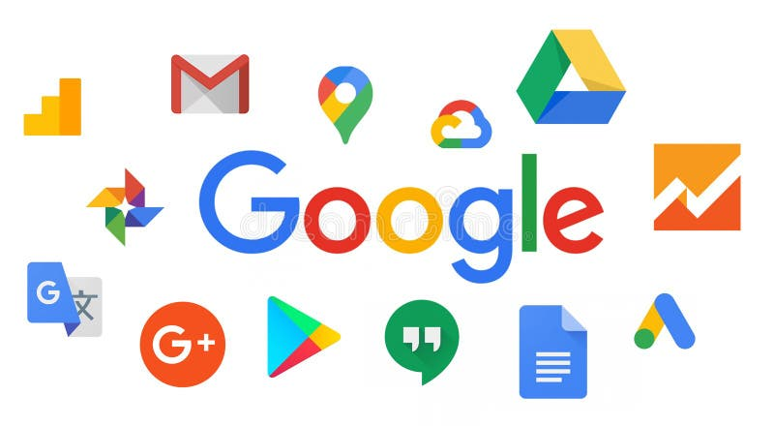
Technologies related to ICT :
Google Services:
Google LLC, founded in 1998 by Larry Page and Sergey Brin, is a prominent American technology company specializing in artificial intelligence, online advertising, search engine technology, cloud computing, software, quantum computing, e-commerce, and consumer electronics.
Google offers a wide range of internet services and products such as:
Gmail
Google Drive
Google Maps
Google docs,sheets,slides
Google Meet

Slide 7



Microsoft Tools and Apps:
Microsoft Corporation, headquartered in Redmond, Washington, Founded by Bill Gates and Paul Allen in 1975, stands as a leading American multinational technology company recognized for its influential role in the software industry.
Microsoft rose to prominence with MS-DOS and Windows, dominating the PC operating system market. Microsoft shifted focus from hardware to cloud computing, becoming a major player with Azure. Microsoft Office provides users with a wide range of softwares and tools .

Slide 8
Microsoft word | Microsoft Word is a powerful word processing software that provides a comprehensive set of features and options for creating and editing text documents. It is a word processing program with features like templates, image support, WordArt, macros, and support for creating and editing documents on mobile devices.
Power Point | PowerPoint primarily focused on producing overhead transparencies, but it swiftly adapted to accommodate color slides and video output. The software's comprehensive set of tools empowers users to craft visually captivating slideshows.
Excel | Excel employs a grid-based structure with cells arranged in rows and columns, facilitating data manipulation through arithmetic operations and functions. Users can represent data visually through various chart types.

Slide 9
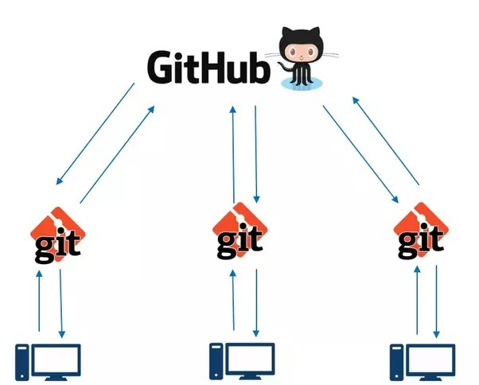


Git and Github:
Version control systems like Git and GitHub are widely used in the field of statistics and data science to manage code and data files efficiently and facilitate collaboration among researchers and analysts. Key features of version control include:
Change Tracking.
Branching and Merging.
Collaboration.
Reproducibility.
Git is an open source software that allows users to track changes
made to files over time, collaborate with others, and manage code
repositories efficiently .
GitHub is a web-based platform that provides hosting for Git
repositories and additional collaboration features . It allows
users to store and manage their Git repositories in the cloud,
making it easy to collaborate with others, track changes, and
access previous versions of files .

Slide 10


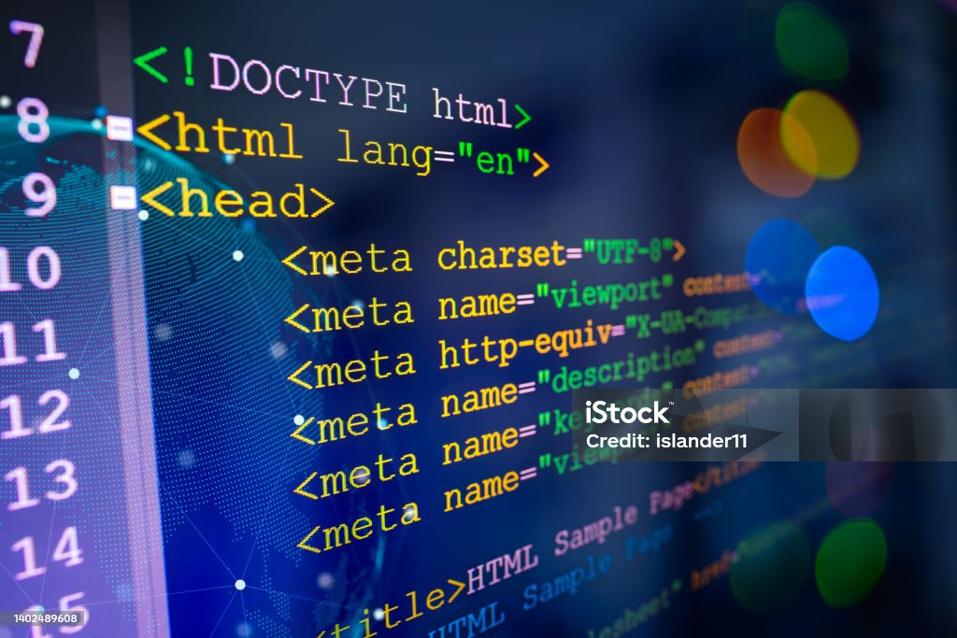
HTML and CSS :
HTML, the HyperText Markup Language, is the unassuming force that defines how documents appear on web browsers. Working in tandem with technologies like Cascading Style Sheets (CSS) and scripting languages such as JavaScript, HTML lays out the blueprint for web pages.
HTML's subtlety lies in its ability to embed programs written in scripting languages like JavaScript, influencing the behavior of web pages. Introducing CSS into the mix defines the visual appearance and layout of the content, ensuring a polished presentation.

Slide 11


Conclusion:
The impact of Information and Communication Technology on various facets of our lives is profound. From education to business practices, the tools and platforms like Google services, Microsoft applications, and Git/GitHub have become integral to our daily operations.

